Slide 1


PROPOSAL-WRITING TIPS
Writing Support Desk
writingsupport@uwindsor.ca

Slide 2

What is a project proposal?
Outlines everything a reviewer needs to know to evaluate your project.
The proposal informs and persuades while combining other project management skills.
e.g., research, data analysis, and some copywriting.
4

Slide 3

7 steps to writing a good proposal
Define the problem
Present your solution
Define Deliverables & Success Criteria
State your plan or approach
Outline Project Schedule & Budget
Tie it all together
Edit/ Proofread your proposal
6

Slide 4

OTHER THINGS TO CONSIDER
Your Audience
Potential Pitfalls
Data and Research Needed
6

Slide 5

Step One: DEFINE THE PROBLEM
4

Slide 6

What’s the problem your project is trying to address?
Why is it a problem?
Why is it worth solving?
Make your audience see the problem the way you see it.
4

Slide 7

Tips
Start Strong – readers don’t have much time to evaluate your proposal.
Use Facts, not opinion – ground your presentation of the problem in data. Don’t exaggerate!
8

Slide 8

STEP TWO: PRESENT YOUR SOLUTION
4

Slide 9
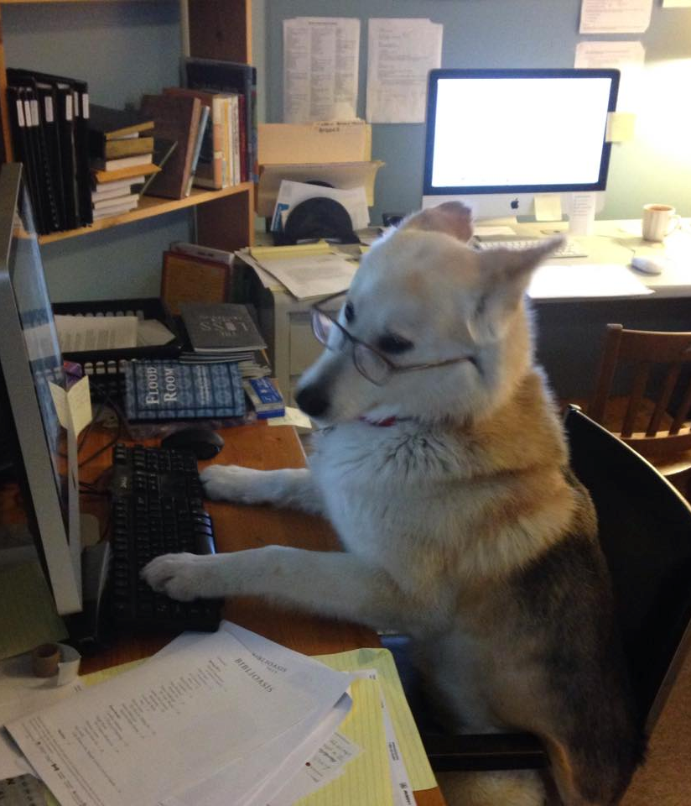
WHERE TO START?
How will your solution solve the problem?
Why is your solution better than other similar solutions?
Discuss why other solutions will not work or not work as well for the situation.
8

Slide 10

Tips
Anticipate Questions & Objections.
Present the solution’s larger impact.
Again, favour fact over opinion.
8

Slide 11

Step 3: DEFINE DELIVERABLES AND SUCCESS CRITERIA
4

Slide 12

This section offers an overview of what your project will provide & an account of how you know if it is successful.
8

Slide 13

Tips
INCLUDE DELIVERY DATES
Not only outline what your project is going to deliver, but also include when you plan to complete EACH deliverable.
8

Slide 14

TIPS
KEEP YOUR SOLUTION
Specific
Measurable
Achievable
Realistic
Time-Based.
8

Slide 15

Step Four: STATE YOUR PLAN OR APPROACH
4

Slide 16

THE NUTS AND BOLTS OF YOUR PROJECT
Introduce your strategy or approach and why it is applicable to this situation.
Discuss how you plan to handle problems and your strategies for mitigating risks.
8

Slide 17

Step Five: Schedule & Budget
4

Slide 18

Tips
Here you outline project costs and detail how you will meet deadlines.
Provide as much detail as possible.
Don’t guess – be as specific as possible!
If there are parts of the project that can be done simultaneously, note this.
6

Slide 19

Step Six: Tie it Together
6

Slide 20

End with a conclusion that summarizes the problem, solution, and benefits
Your proposal should read like a story.
Don’t introduce anything new or extraneous.
Make sure that all of the elements of your project are present.
End with a roar, not a whimper!
6

Slide 21

Step Seven: EDIT AND PROOFREAD
6

Slide 22
Thank you.
writingsupport@uwindsor.ca

